Slide 1



Real Estate Property Search
PROJECT MEMBERS
Kumaresan T (23ITR088)
Nitish M (23ITR113)
Karthik Kulandaippan Shanmugam (23ITR079)
(19ITR028)

Slide 2

Develop a property search system using efficient data structures like hash tables or trees to store and index property.
Implement search algorithms for location, price, and area-based queries, and use sorting methods to display results based on user preferences.
Enhance performance with priority queues, caching, and indexing techniques
Design GUI for real-time updates and provide a user-friendly interface for searching and viewing property details.

Slide 3
Objectives
The objective is to build an efficient property search system that uses advanced data structures and algorithms to store, index, and retrieve property data quickly.
The system aims to provide fast and accurate search results based on multiple criteria like location, price, and area.
It will offer a user-friendly interface, support real-time data updates, and optimize performance with caching and indexing techniques for enhanced user experience.
3

Slide 4
Software / Hardware Tools used
Software used
Eclipse IDE for Java Developers
AWT packages
Canvas packagess
4

Slide 5
Implementation Details
Functions:
Classes:
This Node class consists of the following data member: Property holder name, phone number ,document number, patta number and the Address of the next Node.
Node
This class contains all the data as a list of Nodes named “head”. From the instance of this class, we can get the land details and can be performed other functions like searching the land records.
userData
This class is the Frame for this project. This class is extended from the Frame class in AWT package and implements ItemListener & ActionListener. This container have many items like Labels, TextFields, Button and many more. When the user provides the right details, the visualization of data structure indicates the right position and convey to the user.
searchMain
Github Repo: https://github.com/KumaresanThiyagarajan/RealEstate_Property_Search.git

Slide 6
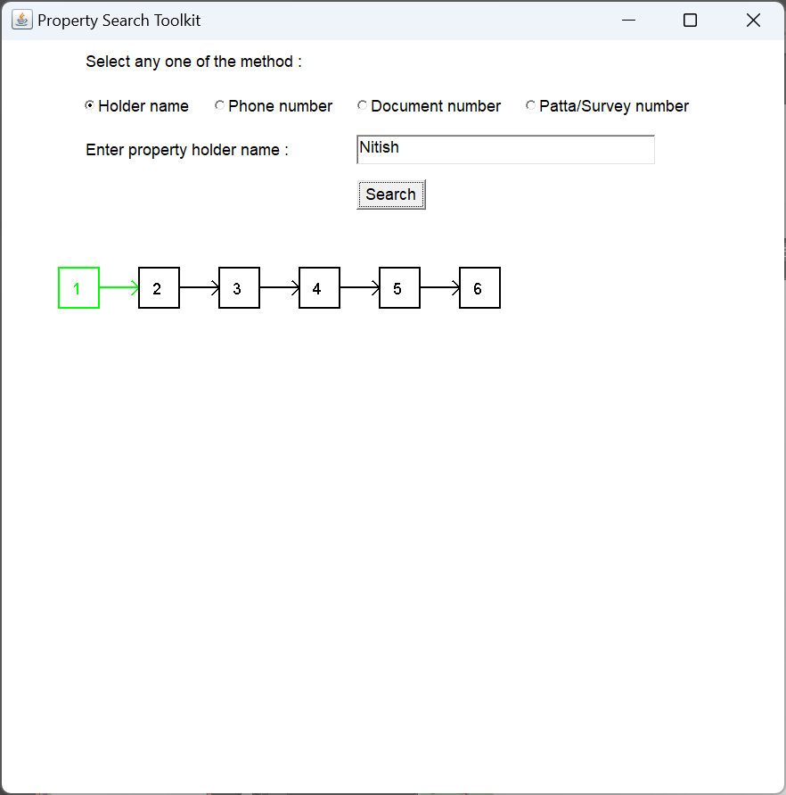
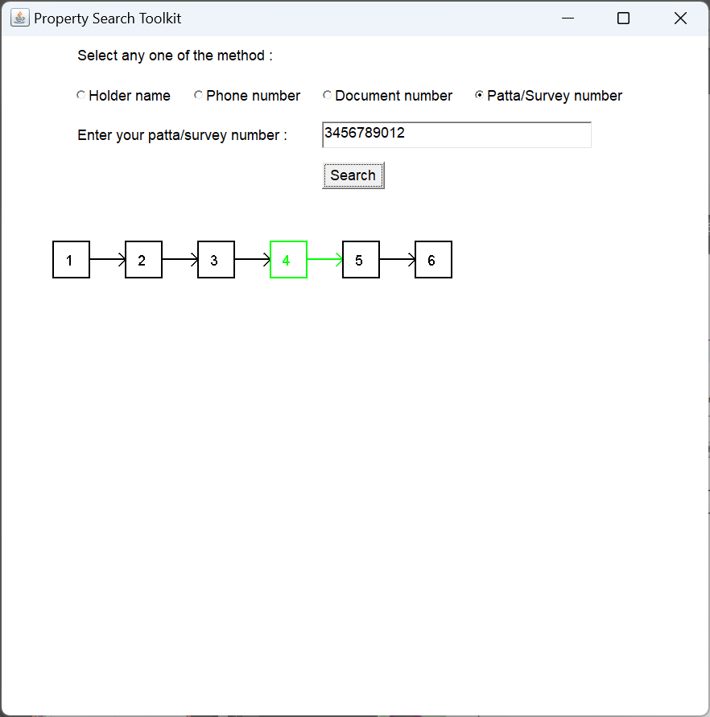
Prototype

Slide 7
List of Reference
Java AWT & Events
https://www.javatpoint.com/java-awt
For time and space complexity
https://www.geeksforgeeks.org/data-structures/

Slide 8
Thank you!

